Slide 1
CAPTION GENERATION BOT

Slide 2
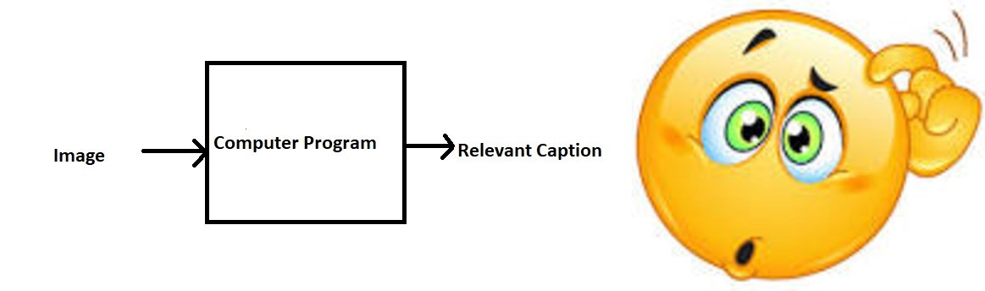

Slide 3
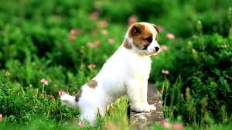
Can you write a caption ?
Well some of you might say “A white dog in a grassy area”, some might say “White dog with brown spots” and yet some others might say “A dog on grass and some pink flowers”.

Slide 4
Motivation
We must first understand how important this problem is to real world scenarios. Let’s see few applications where a solution to this problem can be very useful.
Self driving cars — Automatic driving is one of the biggest challenges and if we can properly caption the scene around the car, it can give a boost to the self driving system.
Aid to the blind — We can create a product for the blind which will guide them travelling on the roads without the support of anyone else. We can do this by first converting the scene into text and then the text to voice. Both are now famous applications of Deep Learning.
CCTV cameras are everywhere today, but along with viewing the world, if we can also generate relevant captions, then we can raise alarms as soon as there is some malicious activity going on somewhere. This could probably help reduce some crime and/or accidents.
Automatic Captioning can help, make Google Image Search as good as Google Search, as then every image could be first converted into a caption and then search can be performed based on the caption.

Slide 5
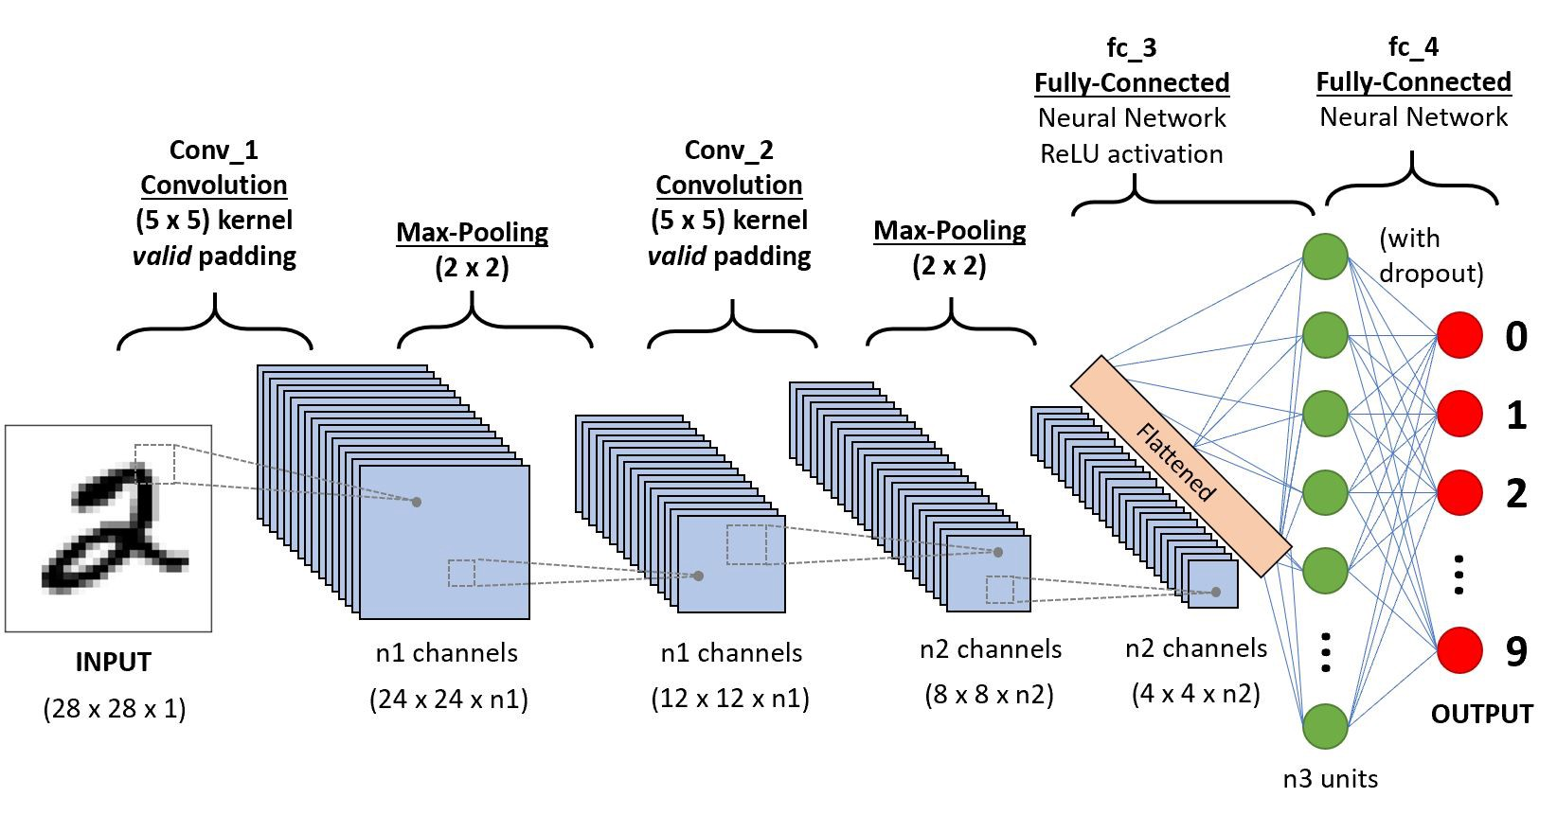
CNN Architecture

Slide 6
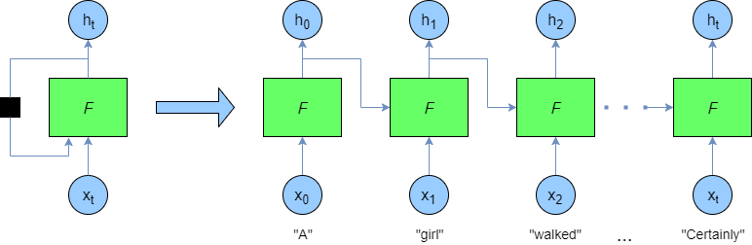
RNN Architecture

Slide 7
Data Collection
There are many open source datasets available for this problem, like Flickr 8k (containing8k images), Flickr 30k (containing 30k images), MS COCO (containing 180k images), etc.
But for the purpose of this case study, I have used the Flickr 30k dataset.
This dataset contains 30000 images each with 5 captions (as we have already seen in the Introduction section that an image can have multiple captions, all being relevant simultaneously).
These images are bifurcated as follows:
Training Set — 29000 images
Test Set — 1000 images

Slide 8
Data Cleaning
Flickr_30k token.txt
Iteration for counting total words
Total Words
(1679081)
Using set() function to remove repeated words
Using threshold frequency to find words with frequency greater than 10
Total Words_1
(5118)
Vocab
(18055)

Slide 9
Loading the training and testing data and manipulating
We have training an testing data given in our datasets so will simply load from there after loading both training and testing data we have .jpg as file extension and we don’t that from training so we will simply remove that from both training and testing data.
After that our model don’t know from where to start and where to end so for that we will add “startseq” in starting and “endseq” in end in training data.
caption
startseq
endseq

Slide 10
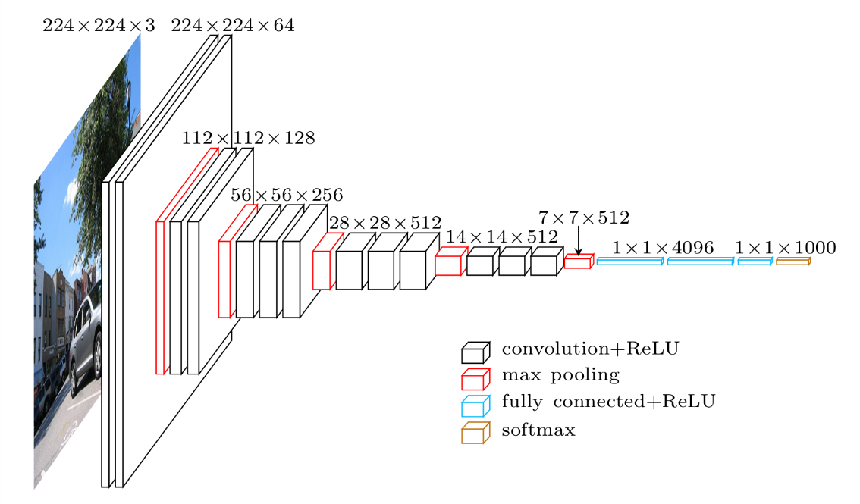
resnet50
it has total 50 layers and it's has better property that it has skip connections so it's skip vanishing gradient.

Slide 11
Data preprocessing - Images
Preprocess image
(reshape image in (224,224,3))
Encode image
(change image into vector)
Feature vector
(vector form of every image)

Slide 12
Data preprocessing - Captions
Word to idx = {}
idx to word = {}
Assign word to word to idx dictionary
Assign index to idx to word dictionary
Add “startseq”
Add “endseq”
Add “startseq”
Add
”endseq”

Slide 13
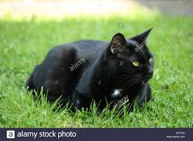
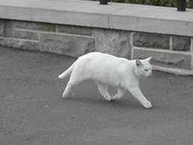
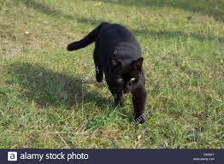
Data Preparation using Generator Function
Consider we have 3 images and their 3 corresponding captions as follows:
Caption1 : The black cat sat on grass
Caption2 -> The white cat is walking on road
Caption3 -> The black cat is walking on grass

Slide 14
Now, let’s say we use the first two images and their captions to train the model and the third image to test our model.
First we need to convert both the images to their corresponding 2048 length feature vector as discussed above. Let “Image_1” and “Image_2” be the feature vectors of the first two images respectively
Caption_1 -> “startseq the black cat sat on grass endseq”
Caption_2 -> “startseq the white cat is walking on road endseq”
vocab = {black, cat, endseq, grass, is, on, road, sat, startseq, the, walking, white}
Let’s give an index to each word in the vocabulary:
black -1, cat -2, endseq -3, grass -4, is -5, on -6, road -7, sat -8, startseq -9, the -10, walking -11, white -12
Let’s take the first image vector Image_1 and its corresponding caption “startseq the black cat sat on grass endseq”.

Slide 15
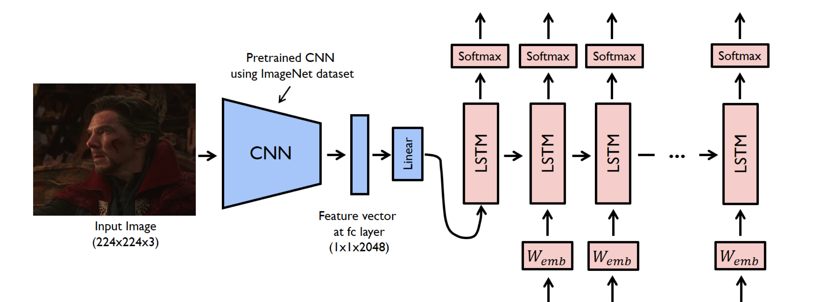

Slide 16
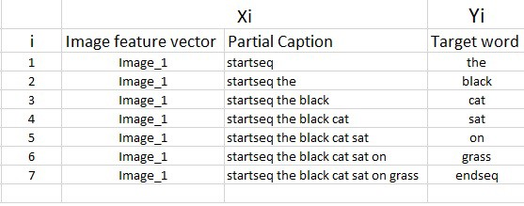
It must be noted that, one image+caption is not a single data point but are multiple data points depending on the length of the caption.

Slide 17
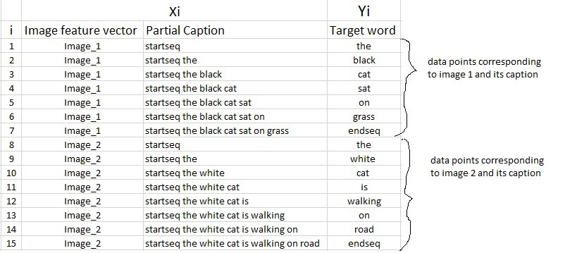
Similarly if we consider both the images and their captions, our data matrix will then look as follows:

Slide 18
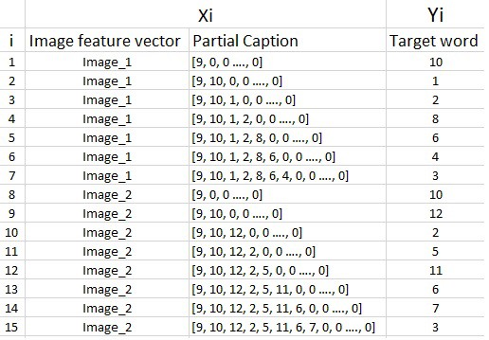
The data matrix will then look as follows:

Slide 19
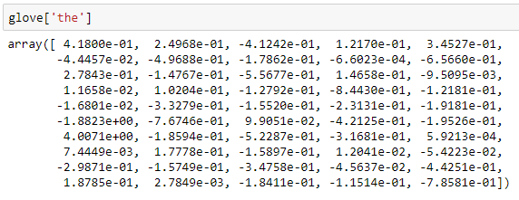
Word Embeddings
GLOVE 6B.50D Intro:
GloVe is an unsupervised learning algorithm for obtaining vector representations for words. Training is performed on aggregated global word-word co-occurrence statistics from a corpus, and the resulting representations showcase interesting linear substructures of the word vector space.

Slide 20
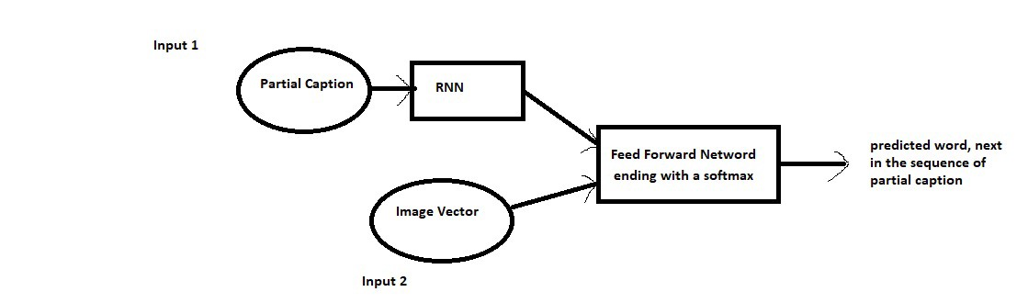
Model Architecture

Slide 21
Finally the weights of the model will be updated through backpropagation algorithm and the model will learn to output a word, given an image feature vector and a partial caption. So in summary, we have:
Input_1 -> Partial Caption
Input_2 -> Image feature vector
Output -> An appropriate word, next in the sequence of partial caption provided in the input_1 (or in probability terms we say conditioned on image vector and the partial caption)
Hyper parameters during training:
The model was then trained for 30 epochs with the initial learning rate of 0.001 and 3 pictures per batch (batch size). However after 20 epochs, the learning rate was reduced to 0.0001 and the model was trained on 6 pictures per batch.

Slide 22

Inference
The third image vector and caption were as follows:
Caption -> the black cat is walking on grass
Also the vocabulary in the example was:
vocab = {black, cat, endseq, grass, is, on, road, sat, startseq, the, walking, white}

Slide 23
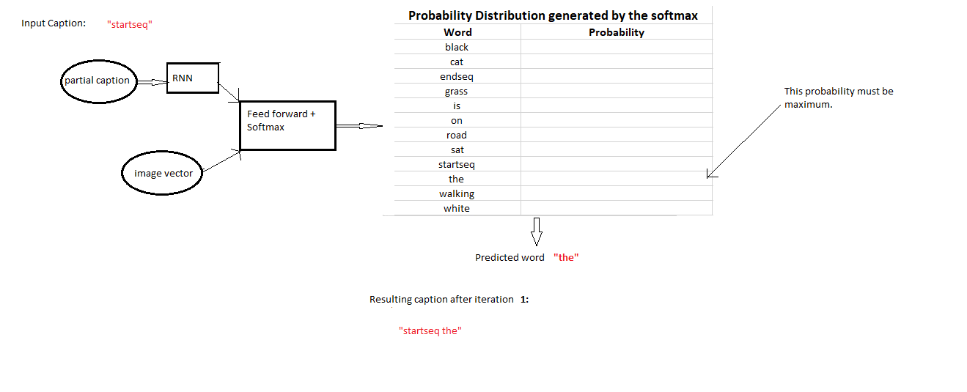
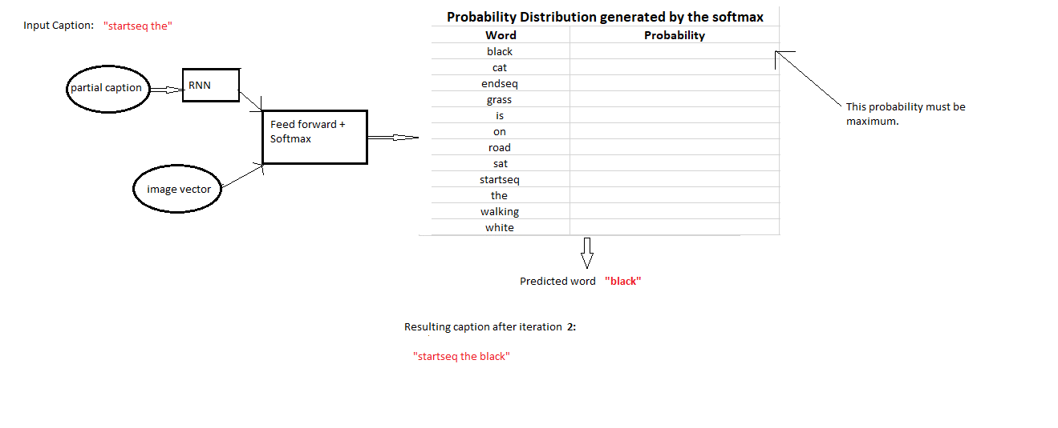
We will generate the caption iteratively, one word at a time as follows:

Slide 24
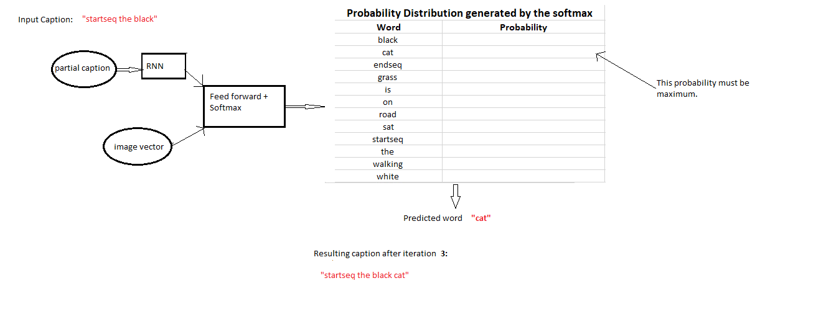
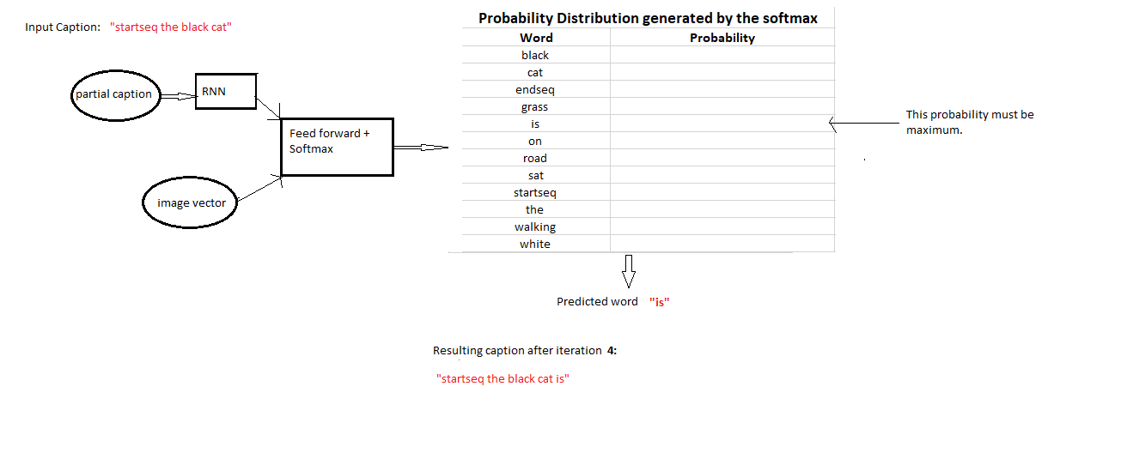

Slide 25
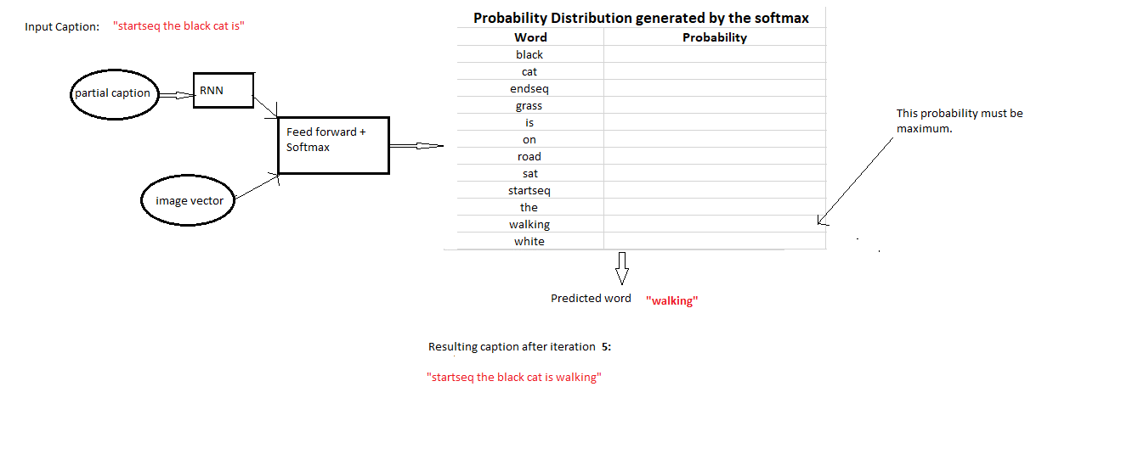
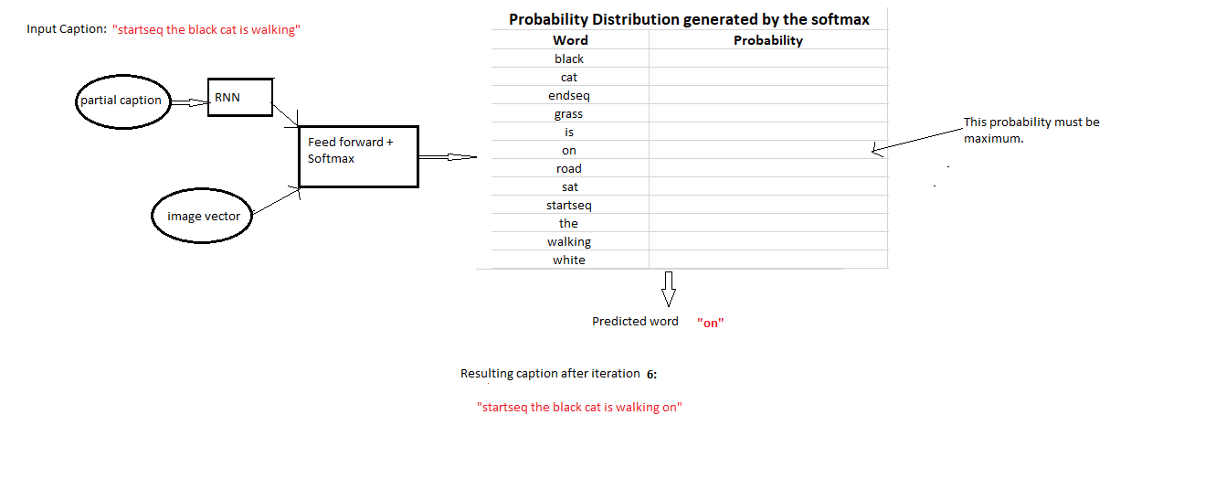

Slide 26
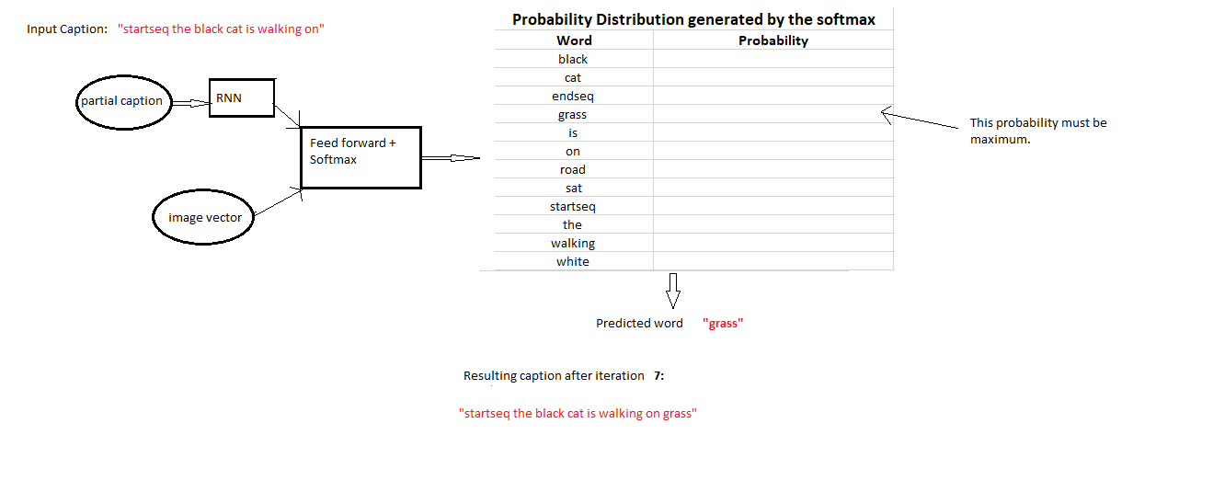
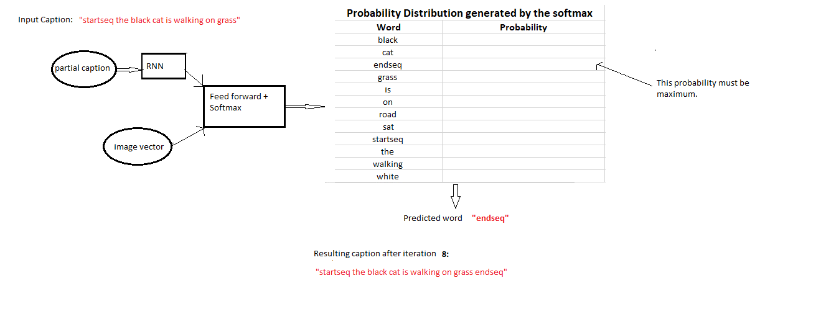

Slide 27
THE END

